Slide 1

Capstone Project Phase 1
Blockchain Private Key Security
Supervisor: Alex Keselman
Karin Shpigelman
Nitzan Shani

Slide 2
Our goals
Research
Algorithm
Development
Notes:
Research: conduct research on the current methods used for securing private keys in cryptocurrency exchanges and large-scale projects based on blockchain technology. The research aims to identify the weaknesses of existing methods.
Algorithm: develop a new algorithm for securing private keys that addresses the identified weaknesses of existing methods.
Development: develop a web application that demonstrates the proposed algorithm.

Slide 3
Table of Contents
Problem Overview
Algorithm
Evaluation
1
2
3
4
5
Introduction
Challenges

Slide 4
1.
Problem Overview

Slide 5

The problem
Unauthorized access to a private key can result in significant financial loss.
Notes:
The main problem is the risk of unauthorized access to the private key used in cryptocurrency exchanges and large-scale projects based on blockchain technology. Private keys are essential for accessing and managing assets associated with a cryptocurrency wallet, and unauthorized access to these keys can result in the loss of assets.
Currently, many methods for securing private keys rely on the use of a single key, which is stored in one place, making it a prime target for hackers. Additionally, many existing methods require human intervention to access the private key, which can lead to delays and errors.

Slide 6
2.
Introduction

Slide 7

Introduction
Cryptocurrency
virtual currency that uses cryptography for security.
Blockchain
digital ledger of transactions
Notes:
A cryptocurrency is a virtual currency that uses cryptography for security. It Bitcoin, the first and most widely used cryptocurrency, was created in 2009. Transactions with cryptocurrencies are recorded on a public digital ledger called a blockchain.
A blockchain is a digital ledger of transactions that is decentralized and distributed across a network of computers. Each block in the chain contains a number of transactions, and every block is linked to the one before it, forming a chain of blocks. This structure creates a permanent, unchangeable record of all transactions on the network.

Slide 8
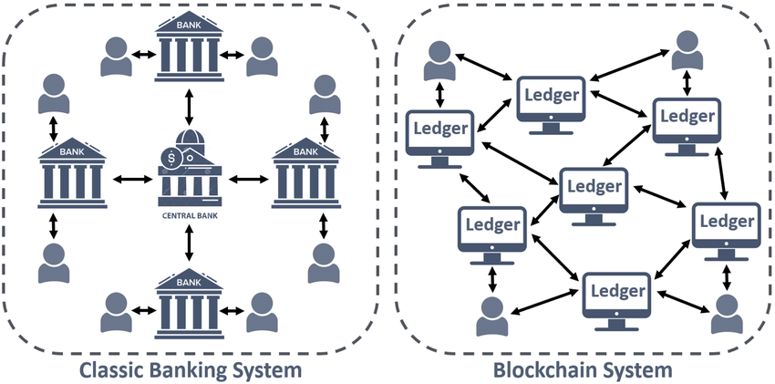
Notes:
Blockchain technology is a decentralized, digital ledger that is used to record transactions across a network of computers. It is a continuously growing list of records, called blocks, that are linked and secured using cryptography. Each block typically contains a cryptographic hash of the previous block, a timestamp, and transaction data.
The key feature of blockchain technology is that it is decentralized, meaning that it is not controlled by a single entity, such as a government or financial institution. Instead, it is maintained by a network of users, often called nodes, who work together to validate and record transactions. This decentralization makes blockchain technology highly secure and resistant to tampering or hacking.
It's important to mention that blockchain technology is the backbone of many cryptocurrencies, such as Bitcoin, Ethereum, Litecoin, and others, but it's also used for non-financial purposes such as Digital Identity, Supply Chain management, Medical records, and more.

Slide 9
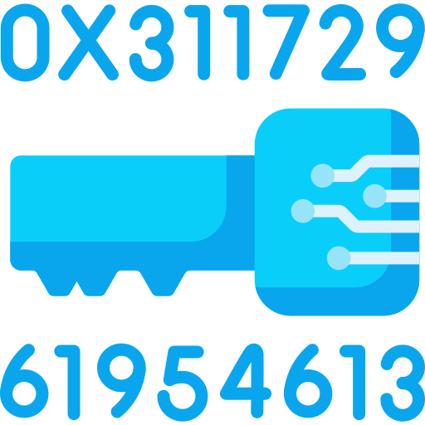
Introduction
Transaction
digital record of an action that is recorded on the blockchain network.
Private and Public Key
pair of keys that are used to encrypt and decrypt data.
Notes:
In cryptography, a public key and a private key are a pair of keys that are used to encrypt and decrypt messages. In blockchain, these public and private keys are used to secure transactions and manage ownership of digital assets.
public key is a string of characters that represents a digital address on the blockchain network, similar to a bank account number. It is used to receive digital assets and view the transaction history of a particular address. Public keys can be shared publicly, and anyone can send digital assets to a public key.
A private key, on the other hand, is a secret key that is used to access and manage the digital assets associated with a particular public key. It is used to sign digital transactions and transfer ownership of digital assets. The private key should be kept secret and protected, as anyone with access to it can sign transactions and move digital assets without the owner's permission.
digital signature is a way to prove the authenticity of a digital document or message, and that it was created by the rightful sender and it has not been tampered with.In blockchain technology, a digital signature is used to authenticate and authorize transactions. It is a mathematical algorithm that is applied to the content of a transaction, creating a unique "fingerprint" that can be used to verify the authenticity of the transaction.
The Bitcoin blockchain uses the Elliptic Curve Digital Signature Algorithm (ECDSA) for digital signatures. ECDSA is a widely-used digital signature scheme that is based on the mathematics of the elliptic curve cryptography (ECC). ECC is a form of public-key cryptography that is considered to be more secure than traditional RSA (Rivest–Shamir–Adleman) encryption for a given key size.

Slide 10


Wallets
Hot Wallet
Cold Wallet
connected to the internet and used for daily transactions.
disconnected from the internet and used to store large amount of crypto assets.
Notes:
A wallet is a digital software program that interacts with the blockchain to enable the user to send and receive digital assets.
Hot wallets: These are wallets that are connected to the internet and are accessible from anywhere. They are easy to use, but they are also more vulnerable to hacking.
Cold wallets: These are wallets that are not connected to the internet and are stored offline. They are more secure than hot wallets, but they are also more difficult to use and are not as accessible.
It's important to note that while cryptocurrency wallets give you the ability to store, send, and receive digital currency, they do not store the actual currency, but rather store the private key which gives you access to it.

Slide 11
Biggest Crypto Exchanges Hack
 | Then | Now
Bitfinex 2016 | $72,200,000 | $2,545,533,536
CoinCheck 2018 | $487,387,361 | $926,988,827
Binance 2019 | $41,167,638 | $149,990,022
* In the last decade
Notes:
Coincheck A Japanese cryptocurrency exchange.The target of the hack, as in most cases, was the hot wallet of the exchange, from which 523 million NEM tokens were stolen
Hong Kong-based Bitfinex, one of the largest cryptocurrency exchanges in the world, lost about $72 million worth of bitcoin in a hack.
hackers were somehow able to trick the BitGo algorithms, forcing them to approve transactions, and withdrew about 120,000 BTC from the exchange’s hot wallet. The immediate effect on the price of Bitcoin was a sharp drop of about 20% following the news of the hack. H
Binance, one of the largest cryptocurrency exchanges
Hackers used a variety of tactics — including phishing and viruses — to obtain a large number of two-factor authentication codes and API keys. The hackers made off with 7,074 BTC
It's worth noting that these are just a few examples of many exchange hacks that have occurred in the past decade. The crypto space is constantly evolving and exchanges have to adapt and improve their security measures to prevent such events, as the value of cryptocurrencies has increased and so has the interest of hackers.

Slide 12
$36,724,262,911
Were stolen due to hacking attacks
*According to the rate 1BTC = $21,284.70 in 17/01/2023
Notes:
in total at least 36,724,262,911$ were stolen due to hacking attack
Thirty-six billion, seven hundred twenty-four million, two hundred sixty-two thousand, nine hundred eleven dollars.
This is converted from BTC to US Dollars

Slide 13
3.
The Algorithm

Slide 14
Algorithm
The private key is a string of 64 characters length, 256 bits.
Splitting the private key into smaller parts and storing them in blocks.
Distributed the blocks across multiple servers.
Notes:
The proposed algorithm addresses these issues by splitting the private key into smaller parts and storing them in blocks, which are then distributed across multiple servers. This approach makes it more difficult for hackers to access and compromise the assets associated with the private key, as they would need to gain access to multiple servers and reassemble the key. Additionally, the algorithm does not require human intervention to access the private key, which eliminates the possibility of delays and errors caused by human intervention.
The private key is a string of 64 characters length, 256 bits.
The private key is divided into 16 smaller parts of 4-character, which are stored in 8-character blocks and distributed across 16 servers.ensuring that each bit of the private key is stored twice in two different servers.
After each withdrawal made in the system, the partitions of the private key will be re-encrypted and re-transmitted to the servers.
adding an extra layer of security. This process ensures that in case of a server failure, the private key can still be accessed and providing an added layer of security against hacking.
In the event of server malfunction, the system has been engineered to maintain functionality through the implementation of redundancy, wherein each character is replicated and stored on two separate servers.

Slide 15
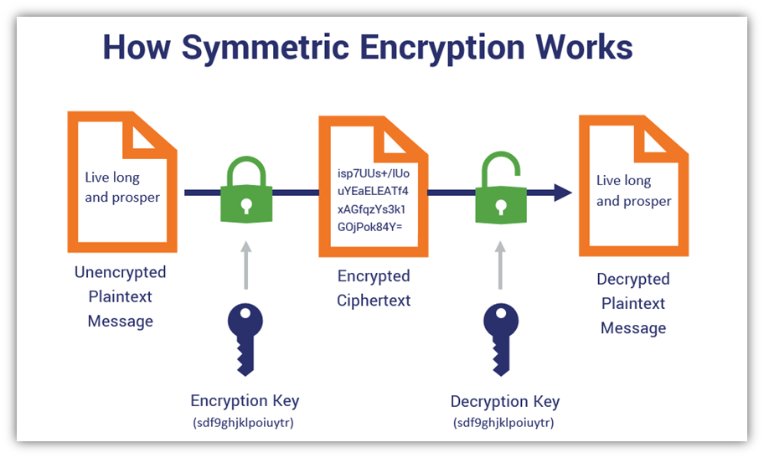
Algorithm
The partitions will be re-encrypted and re-transmitted to the servers.
SSH secure channel.
symmetric algorithm.
Notes:
We encrypt each block before we sent it to a server.
We use symmetric algorithm encryption
**In asymmetric we need to save the different keys to each server, In symmetric encryption we can use the same key and changeit in high frequency which make our algorithm more simple and secure. **
We use the same key both for encryption and decryption for all servers. We change the key in high frequency in order to make it more difficult for attacker to guess the key.
We use SSH to send and receive the data from each server. SSH is a protocol that allows communication between computers in a secure way. It allows the communication after authentication from each side, so attackers can interfere the data transfer.

Slide 16
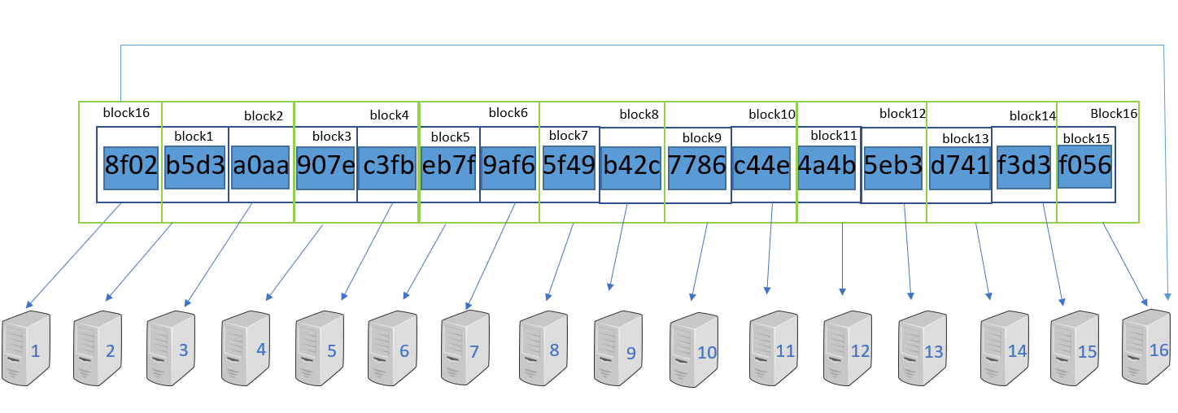
Algorithm
Notes:
This is an example of how our algorithm works.
We can see that the private key that is a 64 characters string, is divided to small parts that contains 4 characters, each.
Each part is saved in 2 different blocks, and each block is saved in a different server.
In total each character is saved in 2 different servers, so our algorithm can handle if there is a problem in one of the servers.
We can see that each part is saved in 2 following blocks, while last block contains the first part and the last part of the private key.

Slide 17
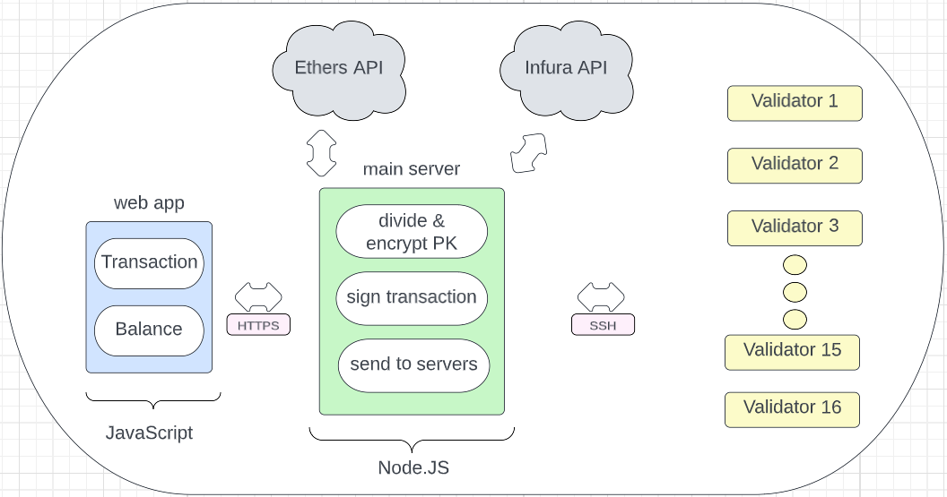
Architecture
Notes:
The proposed architecture for the web application involves the utilization of JavaScript for implementation and communication with the primary server via HTTPS. The primary server,volves the utilization of node.JS and will be equipped with various functionalities that enable communication with storage servers via SSH. To facilitate communication with the storage servers, the primary server will maintain a mapping of the IP addresses of all storage servers using a data structure such as a map. Additionally, the primary server will also utilize the Infura API, a blockchain full node on another server, to track transactions and monitor the balance.
We will use infura and ethers API in order to communicate with remote ethereum blockchain and create transaction.

Slide 18
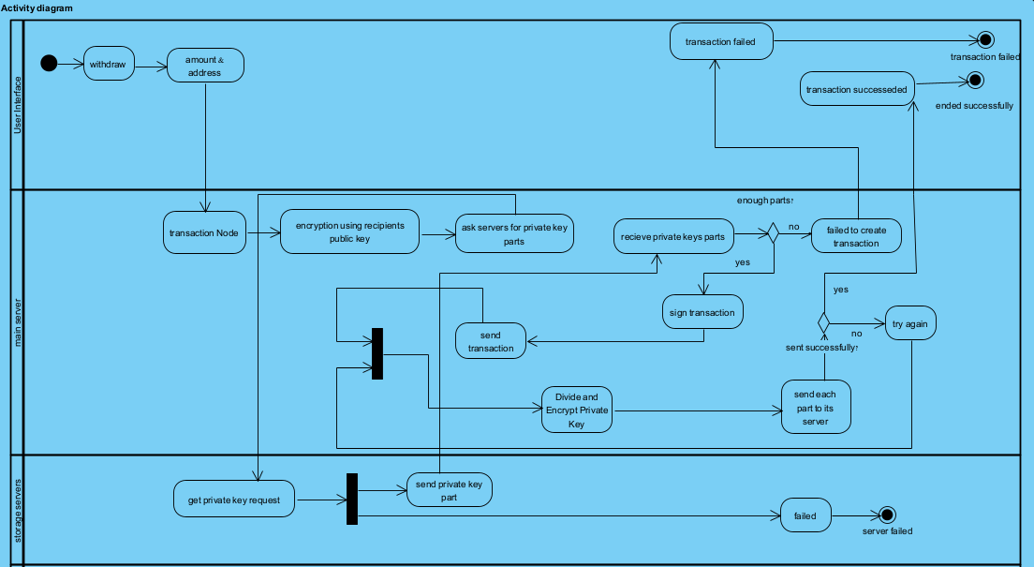
Activity
Notes:
The proposed architecture for the web application involves the utilization of JavaScript for implementation and communication with the primary server via HTTPS. The primary server,volves the utilization of node.JS and will be equipped with various functionalities that enable communication with storage servers via SSH. To facilitate communication with the storage servers, the primary server will maintain a mapping of the IP addresses of all storage servers using a data structure such as a map. Additionally, the primary server will also utilize the Infura API, a blockchain full node on another server, to track transactions and monitor the balance.
We will use infura and ethers API in order to communicate with remote ethereum blockchain and create transaction.

Slide 19
4.
Challenges

Slide 20
Challenges
Synchronization
Component Failure
man-in-the-middle attack
Notes:
If all the servers are stored in one location or same cloud provider and it is compromised, the private key is at risk of being stolen.
distribute the servers across multiple locations and cloud providers.
The servers need to be kept in sync with each other in order to ensure that the private key can be reconstructed when needed.
Master-slave replication- the master server is responsible for managing and distributing the private key, and the slave servers are responsible for storing the key.
Master-slave replication: One way to synchronize servers is to use master-slave replication, where one server acts as the master and the other servers act as slaves. The master server is responsible for managing and distributing the private key, and the slave servers are responsible for receiving and storing the key.
Man in the middle attack is an attack That attacker could intercept the communication between the servers and modify the private key or the way it is divided and distributed. This would allow the attacker to gain access to the private key and compromise the assets associated with it, despite the algorithm's security measures.
To mitigate the risk of these attacks, we implement additional security measures - symmetric encryption. To ensure the integrity and confidentiality of the communication channel between the servers.

Slide 21
5.
Evaluation Plan

Slide 22
Evaluation Plan
1 | generating new private key | valid private key
2 | Dividing the private key | division should be according to the algorithm
3 | Encrypting and decrypting the private key parties | each part should be encrypted
4 | Sending the private key parties to the correct servers | each server should have its part
5 | making a new transaction | the transaction is accepted in blockchain
6 | making a new transaction in case one of the servers if down | the transaction is accepted in blockchain

Slide 23
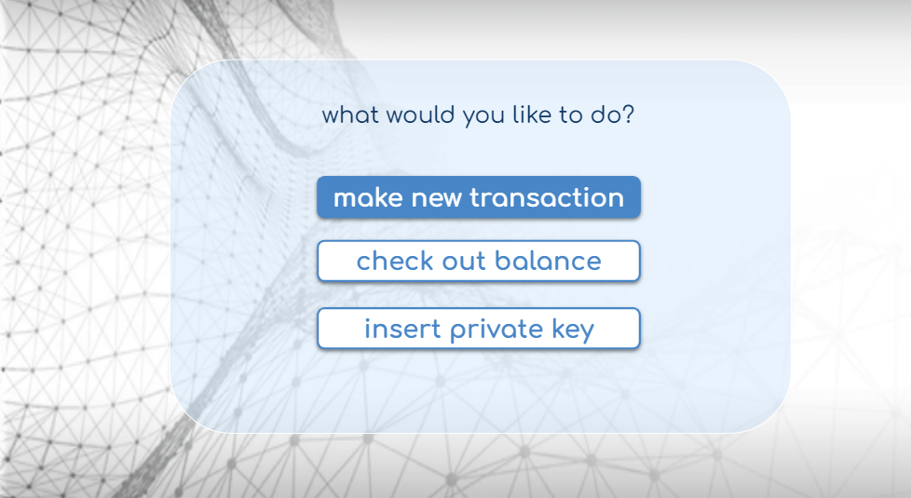
Web project
Notes:
The web application will serve as a test platform to evaluate the functionality and effectiveness of the proposed algorithm.
It will illustrate the proposed solution based on the Ethereum test blockchain. And the symmetric encryption will be BlowFish.
We will assess the system's ability to create valid transactions.
we can ensure that the private key is functioning correctly and that the system is able to sign transactions as expected.

Slide 24
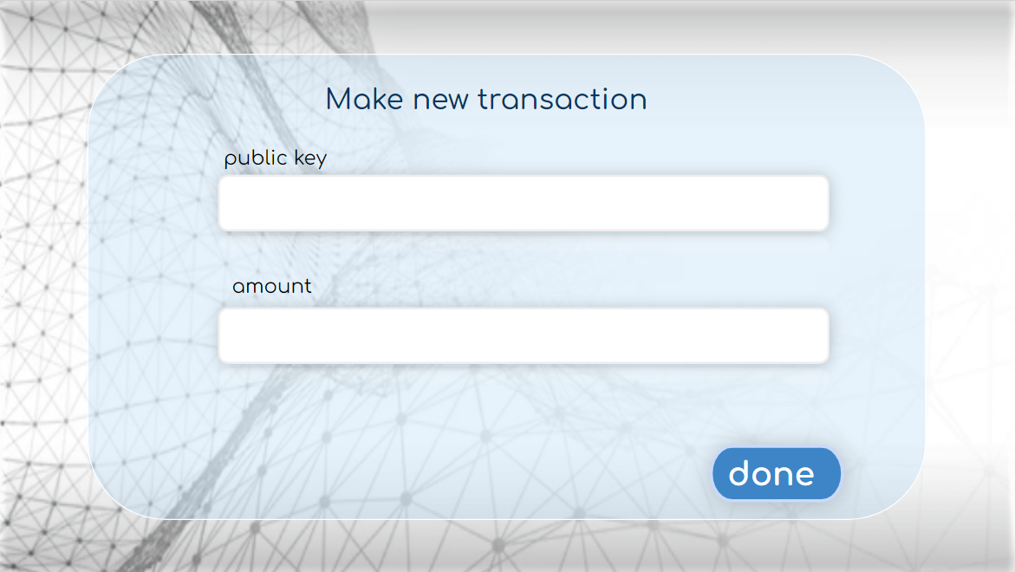
Web project
Notes:
The web application will serve as a test platform to evaluate the functionality and effectiveness of the proposed algorithm.
It will illustrate the proposed solution based on the Ethereum test blockchain. And the symmetric encryption will be BlowFish.
We will assess the system's ability to create valid transactions.
we can ensure that the private key is functioning correctly and that the system is able to sign transactions as expected.

Slide 25
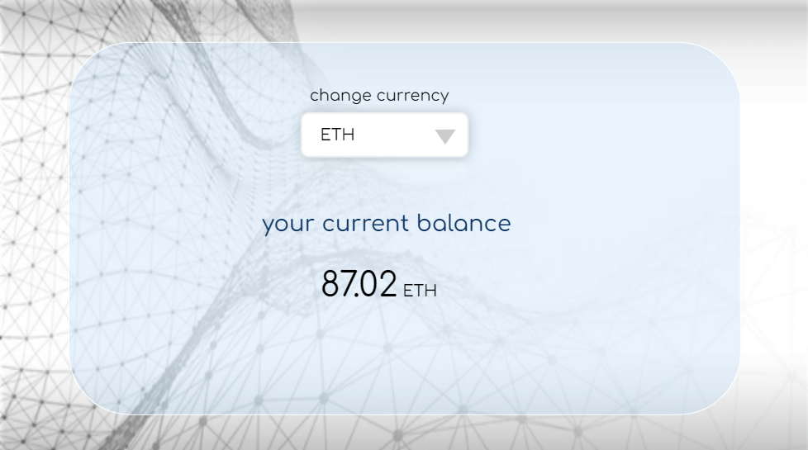
Web project
Notes:
The web application will serve as a test platform to evaluate the functionality and effectiveness of the proposed algorithm.
It will illustrate the proposed solution based on the Ethereum test blockchain. And the symmetric encryption will be BlowFish.
We will assess the system's ability to create valid transactions.
we can ensure that the private key is functioning correctly and that the system is able to sign transactions as expected.

Slide 26
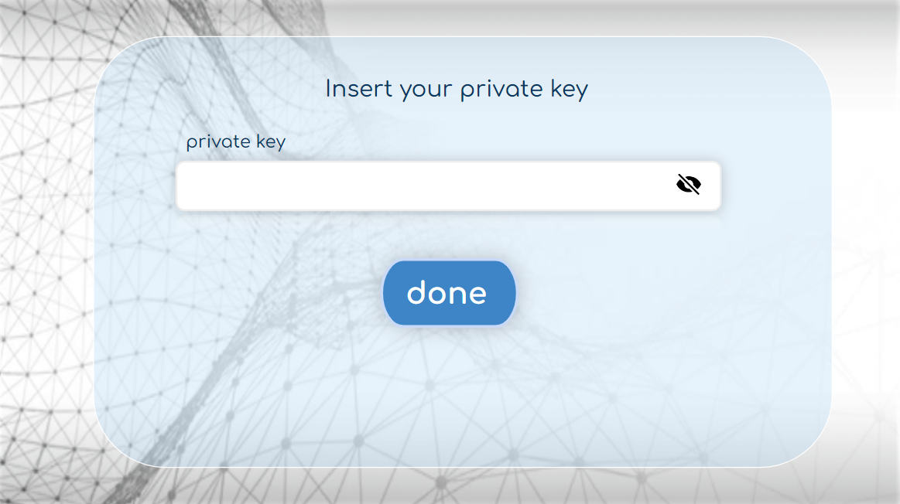
Web project
Notes:
The web application will serve as a test platform to evaluate the functionality and effectiveness of the proposed algorithm.
It will illustrate the proposed solution based on the Ethereum test blockchain. And the symmetric encryption will be BlowFish.
We will assess the system's ability to create valid transactions.
we can ensure that the private key is functioning correctly and that the system is able to sign transactions as expected.

Slide 27

Thanks!
Any questions?

